Slide 1

Semantic Analysis
Sabrina Tarin Chowdhury

Slide 2

What is Semantic Analysis
Following parsing, the next two phases of the "typical" compiler are:
semantic analysis
Intermediate code generation
Semantic is related to the meaning associated with the statement in a programming language.
Makes sure that declarations and statements of program have right meaning.
Meaning is important for at least two reasons –
1. It allows us to enforce rules.
2. It provides the information we need in order to generate an equivalent output program.

Slide 3
What is Semantic Analysis
Defines what the program means
Detects if the program is correct
Helps to translate it into another representation

Slide 4
Syntax Vs Semantics
Syntax describes the construction of a language
Described conveniently by a context-free grammar CFG
It refers to the rules and regulations for writing any statement in a programming language
It does not have to do anything with the meaning of the statement.
A statement is syntactically valid if it follows all the rules.
It is related to the grammar and structure of the language.
Semantics are the meaning of the parts of a programming language
e.g., the number of arguments contained in a call to a subroutine matches the number of formal parameters in the subroutine definition – cannot be counted using CFG
It refers to the meaning associated with the statement in a programming language.
It is all about the meaning of the statement which interprets the program easily.

Slide 5
Syntax Vs Semantics
// C++ program to demonstrate semantic error
#include <iostream>
using namespace std;
// Driver Code
int main()
{
// Return statement before cout
return 0;
// Print the value
cout << " Hello World!";
}

Slide 6
Explanation
// C++ program to demonstrate semantic error
#include <iostream>
using namespace std;
// Driver Code
int main()
{
// Return statement before cout
return 0;
// Print the value
cout << “Hello World!";
}
The output will be blank because the above program is semantically incorrect.
This program has no syntax error as it is following every programming rule but still, it will not print anything on the screen because the return statement is written before the cout statement which causes the program to terminate before printing anything on the screen. This type of situation is considered a semantic error.

Slide 7
Semantic Error Correction
// C++ program to demonstrate basic operation
// without any syntax and semantic error
#include <iostream>
using namespace std;
// Driver Code
int main()
{
// Print the value
cout << " Hello World!";
return 0;
}

Slide 8
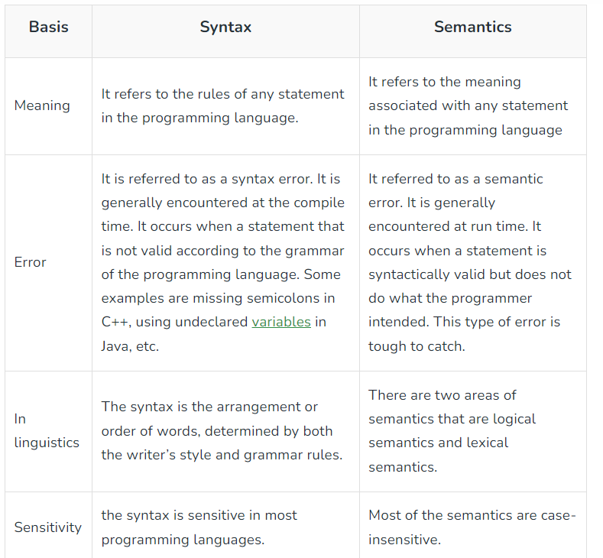
Syntax vs Semantics

Slide 9
Role of Semantic Analysis
Static Semantics –
checked at compile time.
Examples: Type checking; Identifiers are used in appropriate context; Check subroutine call arguments; Check labels
2. Dynamic Semantic Analysis –
Checked at runtime unlike static semantics.
Errors like division by zero, out-of-bounds index in array

Slide 10
Static analysis
Type checking : The compiler ensures that no variable will ever be used at run time in a way that is inappropriate for its type
int a = “value”;
- should not issue an error in lexical and syntax analysis phase.
- should generate a semantic error as the type of the assignment differs
In Java, type checking is mostly static, but dynamically loaded classes and type casts require run-time checks
float myFloat = 9.78;
int myInt = (int) myFloat;

Slide 11
Static analysis
// C program to illustrate aliasing
#include <stdio.h>
// Function to add 10 to b
int alias_testing(int* a, int* b)
{
*b = *b + 10;
return *a;
}
// Driver Code
int main()
{
// Given data
int data = 20;
// Function Call with aliasing
int result = alias_testing(&data, &data);
// Print the data
printf("%d ", result);
}
Examples of static analysis:
Alias analysis : Determines when values can be safely cached in registers, computed “out of order,” or accessed by concurrent threads.
A function takes two pointers A and B which have the same value, then the name A[0] aliases the name B[0] i.e., we say the pointers A and B alias each other.

Slide 12
Static analysis
Escape analysis : escape analysis is a method for determining the dynamic scope of pointers – where in the program a pointer can be accessed.
Stack: Memory allocation happens in the function call stack. The size of memory to be allocated is known to the compiler. And hence it is also called as static memory allocation. Whenever the function call is over, the memory for the variables is de-allocated. Typically, function parameters and local variables are allocated on the stack.
Heap: Memory allocation happens during the execution of the program. And hence it is also called as dynamic memory allocation. For every object created in Heap-space, the referencing information to those objects needs to be stored in order to access them. Usually, we use local variables to store these references,

Slide 13
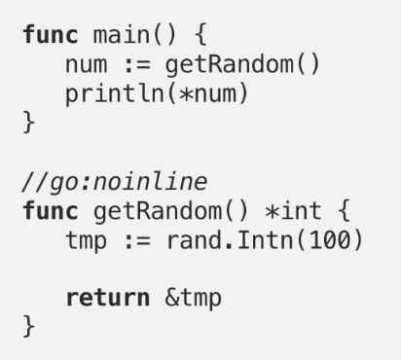
Static analysis
We are trying to return the reference of the local variable tmp to the main. As we know, the local variables will get destroyed on function completion, main function won't be able to access the memory location pointed by num.
While running the escape analysis, Go looks for variables that outlive the current stack frame and therefore need to be heap-allocated. In the above example, compiler detects that tmp variable outlives getRandom stack frame and allocates the memory for it on heap. The variable tmp now contains the address of the allocated memory to the stack and can be safely copied from a stack frame to another one, making it accessible in main.

Slide 14
Dynamic checks
Dynamic checks: semantic rules enforced at run time
C requires no dynamic checks at all (it relies on the hardware to find division by zero, or attempted access to memory outside the bounds of the program)
Java check as many rules as possible, so that an untrusted program cannot do anything to damage the memory or files of the machine on which it runs

Slide 15
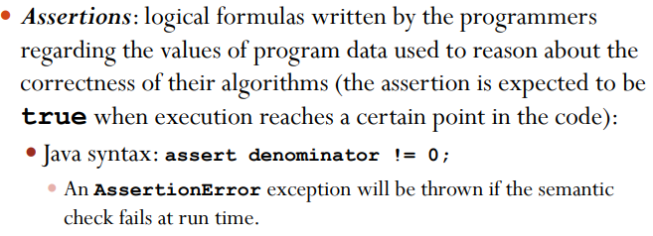
Dynamic checks

Slide 16
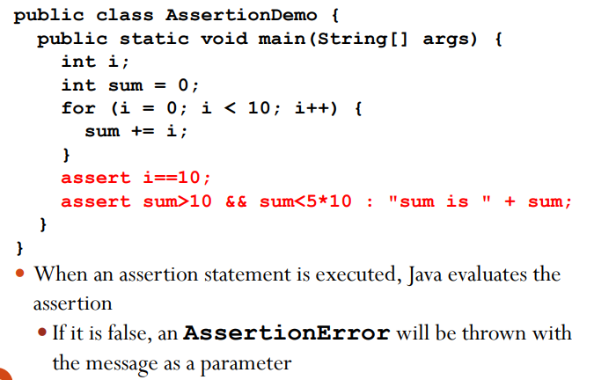
Java Assertion Example

Slide 17
Semantic Errors
Type mismatch
Undeclared variable
Reserved identifier misuse.
Multiple declaration of variable in a scope.
Accessing an out of scope variable.
Actual and formal parameter mismatch.

Slide 18
Types of Semantics
Operational Semantics – the execution of the language is described directly.
Denotational Semantics – each phrase in the language is interpreted as a conceptual meaning that can be thought of abstractly.
Axiomatic Semantics – meaning to phrases is given by describing the logical axioms that apply to them

Slide 19
Operational Semantics
Operational Semantics describe the meaning of a program by executing its statements on a machine, either simulated or actual. The change in the state of the machine (memory, registers, etc.) defines the meaning of the statement.
General approach:
Describe using an intermediate “readable” language
C++ statement: Meaning:
for (x = 0; condition; x++) { x = 0;
… loop: if condition is false, goto out
} …
x++;
goto loop
out: …

Slide 20
Operational Semantics, Evaluation
A hardware only interpreter would be too expensive
A software only interpreter also has problems:
- The detailed characteristics of the particular computer would make actions difficult to understand such a semantic definition would be machine- dependent
A better alternative: A complete computer simulation The process includes
1. Build a translator
2. Build a simulator for the idealized computer

Slide 21
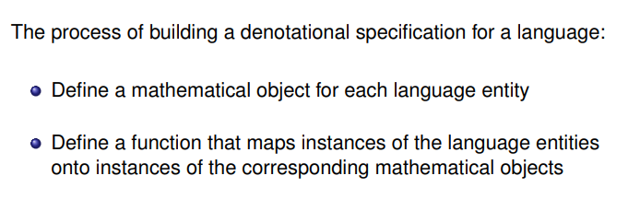
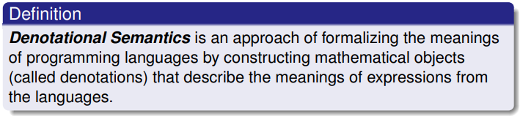
Denotational Semantics
Based on math (and recursion!)

Slide 22
Denotational Semantics
In math, use functions to create a mapping:
x = y + 1
Here, mapping syntax to semantics
Someone enters: 219
Computer reads it as a string, but what is the meaning?
First, define syntactic domain:
<dec_num> -> ‘0’ | ‘1’ |’2’ |… | ‘9’ |
<dec_num> (‘0’ | ‘1’ | ‘2’ | … |’9’)
(Show 219 can be derived by this grammar.)

Slide 23
219 Example, continued
Syntax | Semantic | Meaning
dec_num 9 dec_num 1 2 | 10*dec_num + 9 10*dec_num+1 2 | = 10*21+9 = 219 =10*2+1 = 21
Create semantic mappings:
M_{dec}(‘0’)=0, M_{dec}(‘1’)=1, M_{dec}(‘2’)=2, … , M_{dec}(‘9’)=9
M_{dec}(<dec_num> ‘0’ ) = 10 * M_{dec}(<dec_num>)
M_{dec}(<dec_num> ‘1’ ) = 10 * M_{dec}(<dec_num>) + 1
M_{dec}(<dec_num> ‘2’ ) = 10 * M_{dec}(<dec_num>)+ 2
…
M_{dec}(<dec_num> ‘9’ ) = 10 * M_{dec}(<dec_num>) + 9

Slide 24
Denotational Semantics, Evaluation
Provides a concise way to describe a language
If the denotational description is too complex, maybe the language is too complex
Too complex to be too useful to users

Slide 25
Axiomatic Semantics
Specifies what can be proven about a program -- very abstract
Different from other approaches
No model of how machine changes state
Related to correctness proofs
Show a program is correct by arguing that there are constraints on variables
The logic expressions are called assertions

Slide 26
Axiomatic Semantics, Vocab
Assertions (or predicates):
Describes the constraints on a variable at that point in a program
Preconditions (what must be true before the line executes)
Postconditions (what must be true after the line executes)
Use postconditions to compute preconditions
Ex: sum = 2 * x + 1 //all variables are integers
{sum > 1} //postcondition
What are some preconditions for x?

Slide 27
Weakest Precondition
The least restrictive precondition
Same example:
Ex: sum = 2 * x + 1 //all variables are integers
{sum > 1} //postcondition
{x > 10}, {x > 50}, {x > 1000} //possible preconditions
What is the weakest (least restrictive) precondition?

Slide 28
Let’s Try:
Two checks:
Equality
Inequality according to your precondition
What is the weakest precondition for:
a = b / 2 – 1 {a < 10}
Answer {b < 22}
x = 2 * y – 3 {x > 25}
Answer {y >14 }

Slide 29
Axiomatic Semantics, Evaluation
A good framework to reason about programs
Limited in practical use for programming language or compiler designers

